Slide 1
Oop - Java inheritance
Lecture # 5

Slide 2
Inheritance Concept
Inheritance advantages
Inheritance Terminology and Keywords
Is-a relationship, instanceOf keyword
Inheritance types in Java
Inheritance and Access Specifiers
Constructors and Inheritance
Inheritance and Method Overriding

Slide 3
Inheritance concept
Inheritance in Java is a mechanism in which one object acquires all the properties and behaviors of a parent object.
The purpose of inheritance, is to provide the reusability of code so that a class has to write only the unique features and rest of the common properties and functionalities can be inherited from the another class.
A class can only inherit the fields and methods of another class, if it extends the class.
class A extends B
{ }
Inheritance Concept Terminologies:
Child Class – Sub Class – Drived Class: The class that extends the features of another class. In the above code, class A is the child class.
Parent Class – Super Class – Base Class: The class that shares the fields and methods with the child class. In the above code, Class B is the parent class.

Slide 4
Advantages of Inheritance
Inheritance removes redundancy from the code. A class can reuse the fields and methods of parent class. No need to rewrite the same redundant code again.
Inheritance allows us to reuse of code, it improves reusability in your java application.
Reduces code size: By removing redundant code, it reduces the number of lines of the code.
Improves logical structure: Improves the logical structure of the code that allows programmer to visualize the relationship between different classes.

Slide 5
Is-a relationship
Class Teacher{}
Class PhysicsTeacher extends Teacher{}
A child class has IS-A relationship with the parent class.
Based on the above example we can say that PhysicsTeacher IS-A Teacher.
This is why inheritance is known as IS-A relationship between child and parent class
Car is a Vehicle
Orange is a Fruit
Surgeon is a Doctor
Dog is an Animal

Slide 6
Java Inheritance instanceof keyword
The instanceof keyword returns true, if an object belongs to the class or its parent class.
Reference Example in the class

Slide 7
Types of inheritance in Java
There are four types of inheritance in Java:
Single
Multilevel
Hierarchical
Hybrid
Note: No Multiple Inheritance

Slide 8
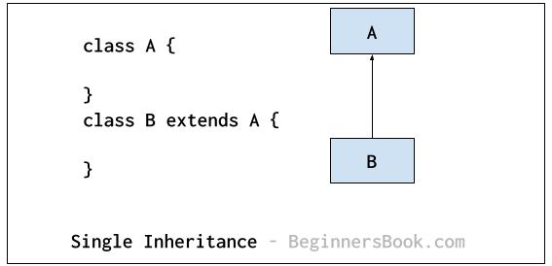
Single Inheritance

Slide 9
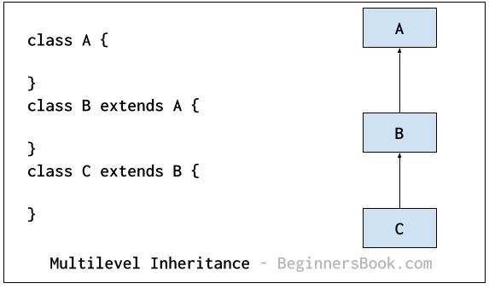
Multilevel Inheritance

Slide 10
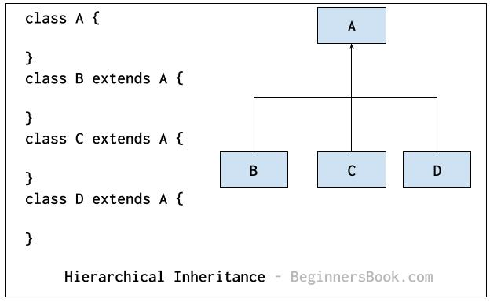
Hierarchical Inheritance

Slide 11
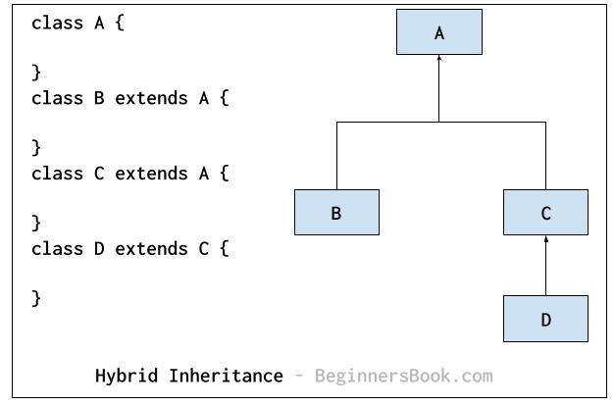
Hybrid Inheritance

Slide 12
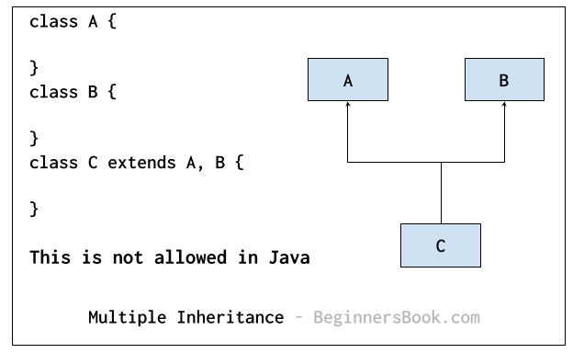
Multiple Inheritance
It refers to the concept of one class extending more than one classes, which means a child class has more than one parent classes. For example class C extends both classes A and B. Java doesn’t support multiple inheritance

Slide 13
Inheritance Access Specifier in Java
The derived class can inherit only those data members and methods of parent class, that are declared as public or protected.
If the members or methods of super class are declared as private then the derived class cannot access them.
The private members can be accessed only in its own class. Such private members can only be accessed using public or protected getter and setter methods of super class

Slide 14
constructor in inheritance in java
Constructor of sub class is invoked when we create the object of subclass, it by default invokes the default constructor of super class. Hence, in inheritance the objects are constructed top-down.
----Important----

Slide 15
constructor in inheritance in java
The superclass constructor can be called explicitly using the super keyword, but it should be first statement in a constructor.
The super keyword refers to the superclass, immediately above of the calling class in the hierarchy.
The use of multiple super keywords to access an ancestor class other than the direct parent is not permitted.
Example Reference in the class…

Slide 16
Inheritance and Method Overriding
When we declare the same method in child class, which is already present in the parent class then this is called method overloading.
In such case, when we call the method from child class object, the child class version of the method is called.
However we can call the parent class method using super keyword then it calls the parent class method as shown below

Slide 17
The use of super keyword
To access the data members of parent class when both parent and child class have member with same name
To explicitly call the no-arg and parameterized constructor of parent class
To access the method of parent class when child class has overridden that method.

Slide 18
The use of super keyword
Examples in the class
What if the child class is not overriding any method: No need of super

